Slide 1

Trading Team 2
Ben Belke, William Ho, Kai

Slide 2
SUMMARY
Initial step
Set up GitHub
Research on Range trading
Mid Term
Visualise different indicators
Dive into machine learning
Explore linear regression and KNN
Final step
Apply machine learning

Slide 3
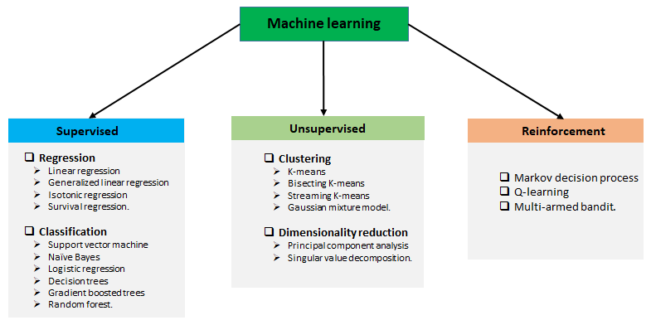
Machine-Learning
Our Model: Linear Regression

Slide 4
Feature Engineering
The aim of feature engineering is to prepare an input data set that best fits the machine learning algorithm as well as to enhance the performance of machine learning models.
Factors:
- ATR15Min_wav
- ATRHour_wav
- 5Candle
- 50Candle

Slide 5
Strategy
Once we had generated an expected return (EV) we bought and sold based of this return.
BUY when EV is larger than 0.025 (or 2.5%) and it has been at least 90 periods since last sold
SELL when EV is smaller than 0 and it has been at least 180 periods since last bought.
We had to add the 90 and 180 period condition due to long periods of constant buy signals – simulating buy and hold and leaving us overly exposed.

Slide 6
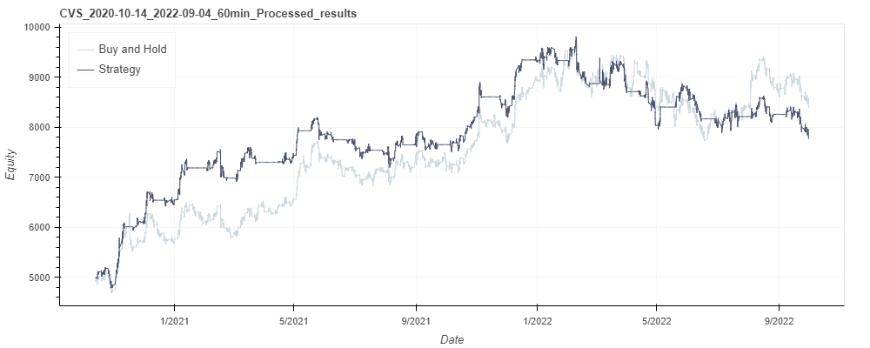
Results

Slide 7
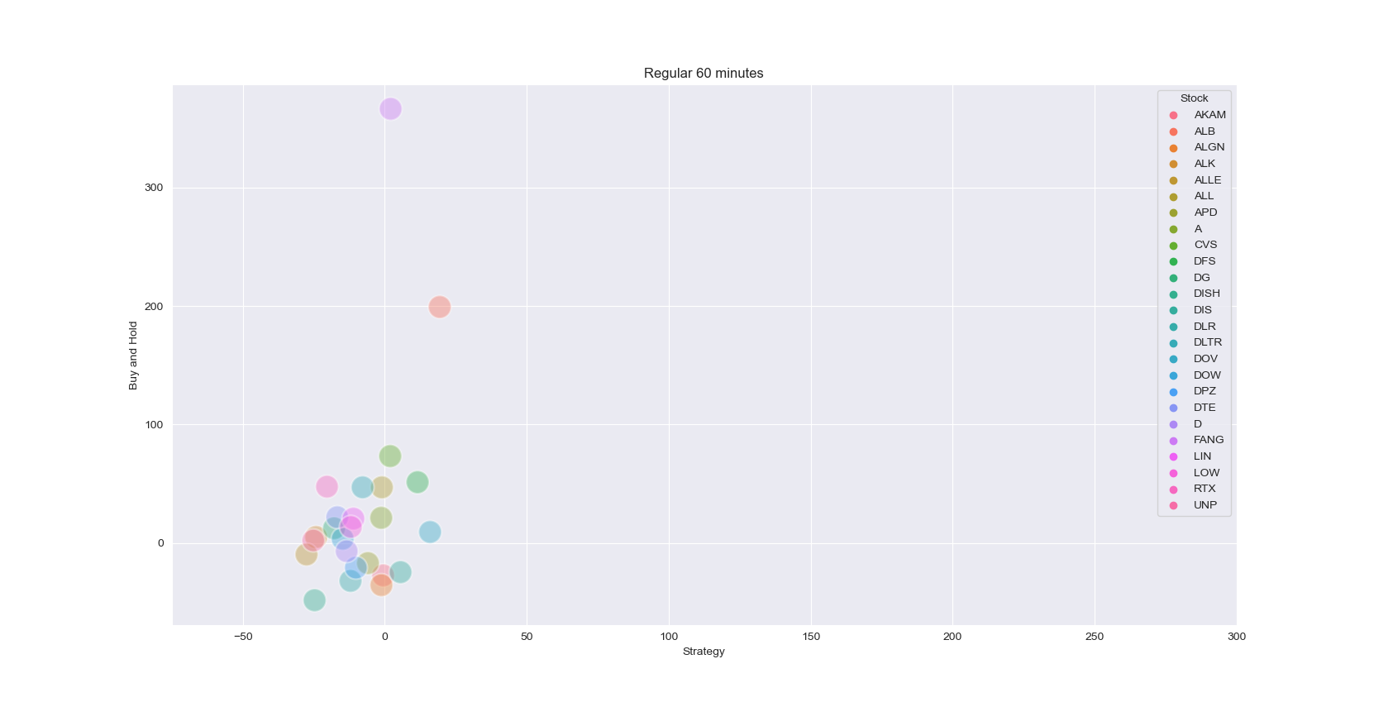
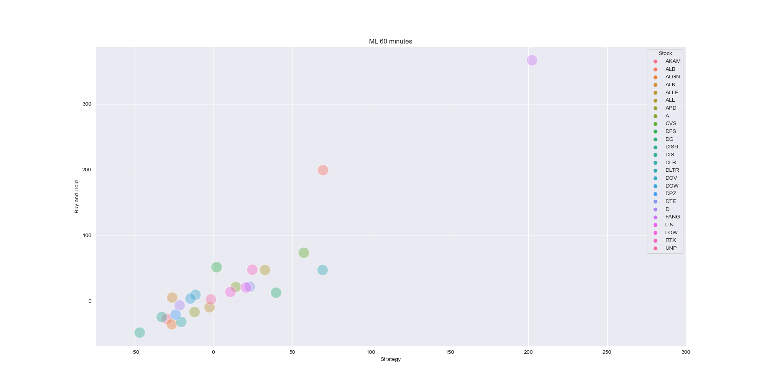
General-view

Slide 8
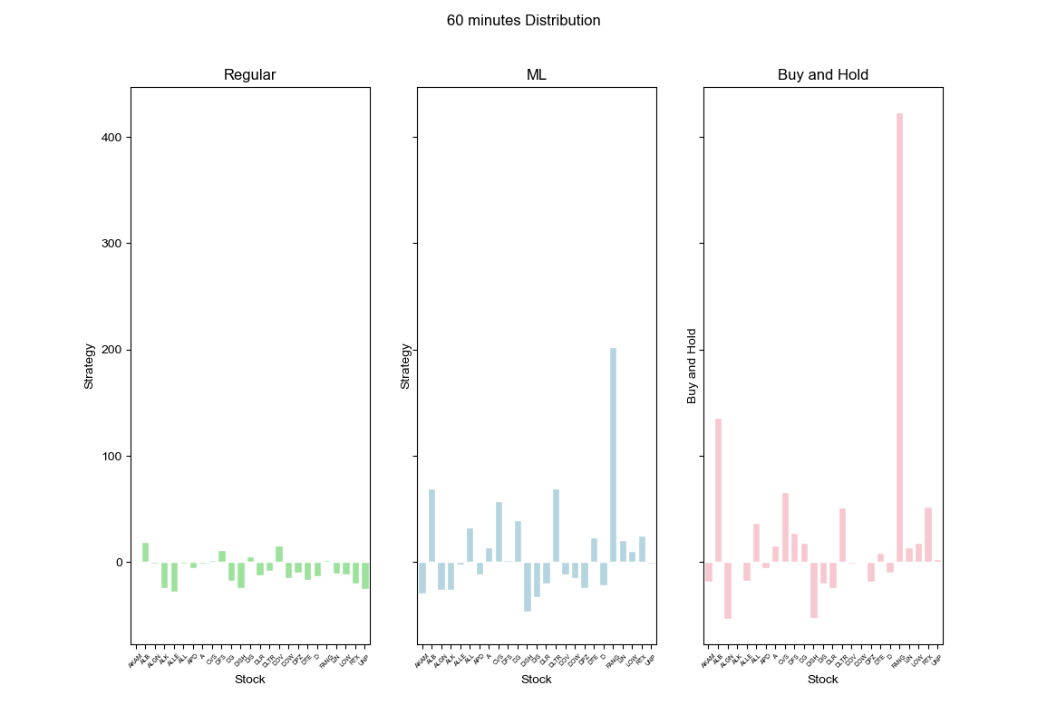
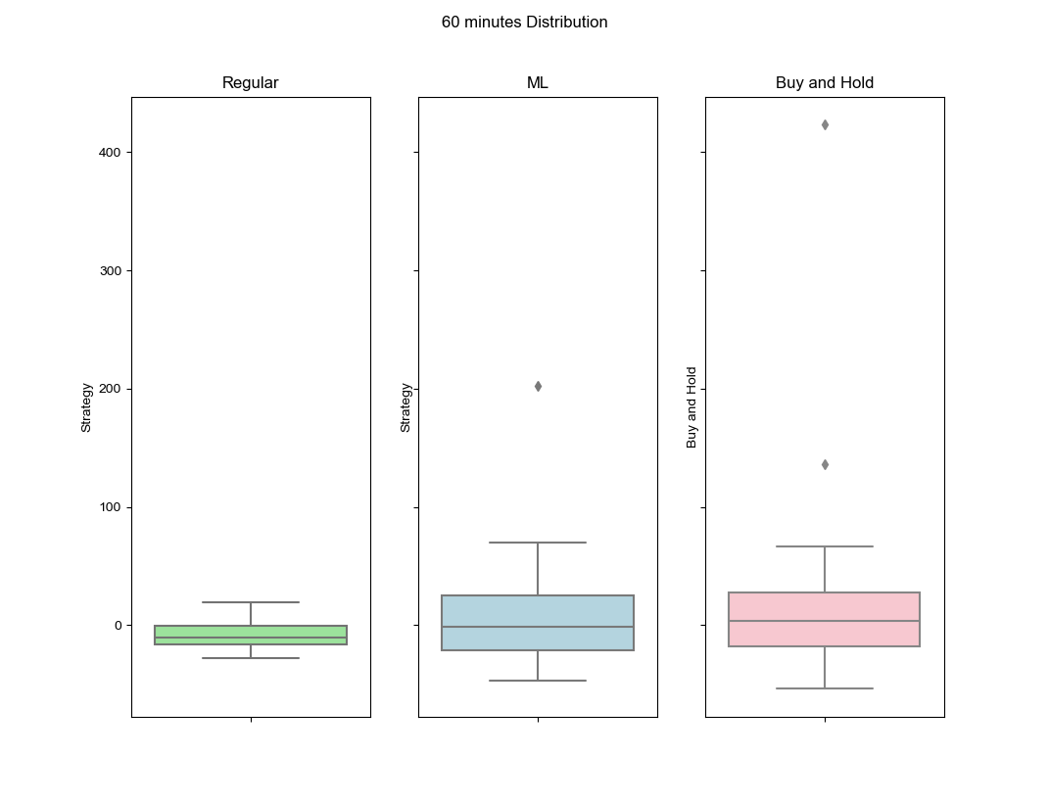
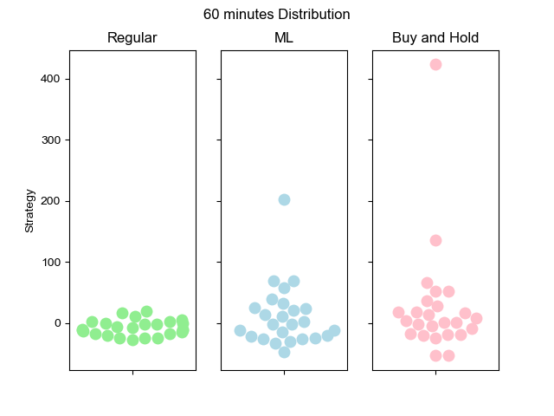
Comparison

Slide 9
Limitations/Challenges
Crashes/Algorithm running time
Need to learn machine learning from scratch
Huge communication problem and rushed a lot in the end

